Slide 1
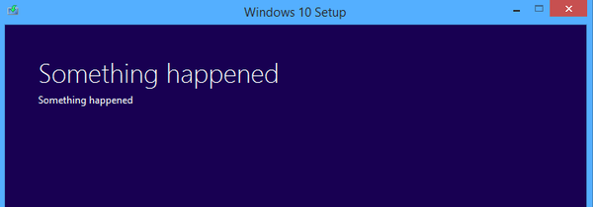
Troubleshooting in R and Linux: What to do when things break
Emily Conklin (she/they)
Data Skills Workshop, 2024

Slide 2
Troubleshooting Session Outline
Review of R basics
Common errors and warnings in R
Using and understanding stack traces
Debugging tools in R and Linux/Unix
Still stuck?: Resources for problem-solving
Intro
R Review
Stack Trace
Errors
Debugging
Linux

Slide 3
Back to basics: Why bother?
Many bugs are caused by errors in data type or data structure
x <- “3”
y <- “4”
x + y
Error in x + y : non-numeric argument to binary operator
R Review
Intro
Stack Trace
Errors
Debugging
Linux
Notes:
Basically, your function is expecting an object to look one way but it’s given another
Without a solid understanding of how data looks to R, debugging is very difficult
Primitive / non-primitive

Slide 4
R data types
Also known as “scalar” or “primitive” – holds a single value
character | “abc123”
Numeric (double, float) | 123.97
logical | TRUE
integer | 123L
complex | 1+4i
raw | 0x28
R Review
Intro
Stack Trace
Errors
Debugging
Linux

Slide 5
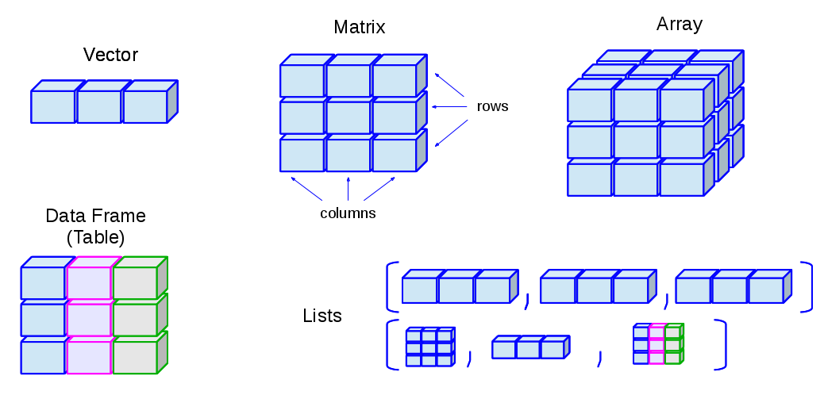
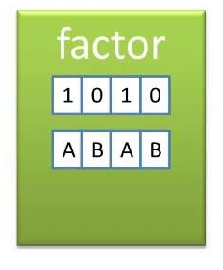
R data structures
Hold more than one value
SATYAJIT MAITRA, Jonatan Lindh
R Review
Intro
Stack Trace
Errors
Debugging
Linux

Slide 6
Examining objects in R
R gives us lots of ways to look at objects!
class() - what kind of object is it?
typeof() – what’s the data type?
length(); dim() - how big is it?
attributes() - does it have any metadata?
R Review
Intro
Stack Trace
Errors
Debugging
Linux

Slide 7
Exercise 1: Review of R data types
Download:
02exercise_seq-workshop_debugging.Rmd
from GitHub and open it in RStudio.
Try running through Exercise #1!
R Review
Intro
Stack Trace
Errors
Debugging
Linux

Slide 8


If-else, for-loops, and functions
If cold, get under blanket
Otherwise, don’t!
For each glass:
Add lime juice
Add simple syrup
Add tequila
Drink?
R Review
Intro
Stack Trace
Errors
Debugging
Linux

Slide 9

If-else, for-loops, and functions
Input:
Ground coffee
Water
Output:
Hot coffee
coffee_maker <- function(p1, p2){
#make coffee with p1, p2
return(coffee)
}
hot_coffee <- coffee_maker(ground_coffee, water)
R Review
Intro
Stack Trace
Errors
Debugging
Linux

Slide 10
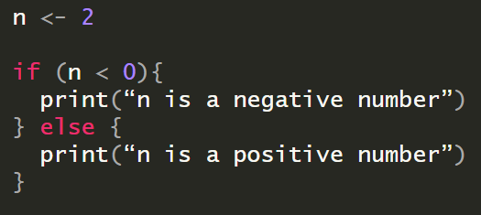
Using if-else statements in R
R Review
Intro
Stack Trace
Errors
Debugging
Linux

Slide 11
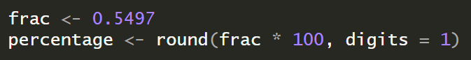
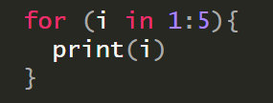
Using for-loops and functions in R
Functions are machines that turn input into output
For-loops run a chunk of code “n” times
R Review
Intro
Stack Trace
Errors
Debugging
Linux
Notes:
Run this as a demo (print “x” inside and outside function)

Slide 12
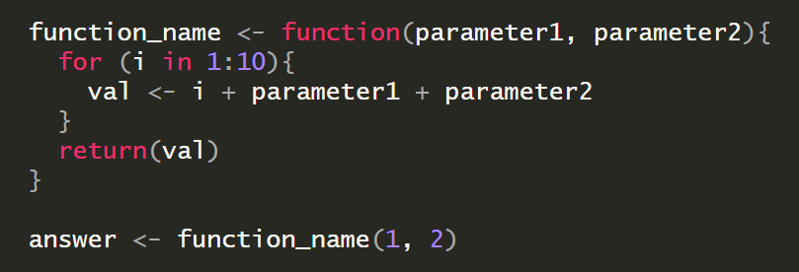
Defining your own functions
R Review
Intro
Stack Trace
Errors
Debugging
Linux
Notes:
Run this as a demo (print “x” inside and outside function)

Slide 13
Exercise 2: If, functions, for-loops
Try running through Exercise #2 in your Rmarkdown file!
R Review
Intro
Stack Trace
Errors
Debugging
Linux
Notes:
Build off first exercise

Slide 14
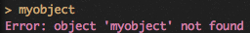
Scope is a common problem
Variables created inside a function cannot be accessed outside the function!
R Review
Intro
Stack Trace
Errors
Debugging
Linux
Notes:
Go back to previous slide

Slide 15
Prevention is the best medicine
Keeping track of variables can help us avoid and troubleshoot errors
Stack Trace
Where objects are stored in memory
Tracing these objects
Stack Trace
Intro
R Review
Errors
Debugging
Linux
Notes:
Build off first exercise

Slide 16
Exercise 2: Stack traces
statement
j
i
nums
fruits
"We have 1 papaya and 3 breadfruit"
3
1
c(2, 4, 7)
c(“papaya”, “breadfruit”)
variable
stack
Stack Trace
Intro
R Review
Errors
Debugging
Linux
Notes:
Build off first exercise

Slide 17
Exercise 2: Stack traces
statement
j
i
nums
fruits
"We have 1 papaya and 3 breadfruit"
3
1 2
c(2, 4, 7)
c(“papaya”, “breadfruit”)
variable
stack
Stack Trace
Intro
R Review
Errors
Debugging
Linux
Notes:
Build off first exercise

Slide 18
Exercise 2: Stack traces
statement
j
i
nums
fruits
"We have 1 papaya and 3 breadfruit"
3 6
1 2
c(2, 4, 7)
c(“papaya”, “breadfruit”)
variable
stack
Stack Trace
Intro
R Review
Errors
Debugging
Linux
Notes:
Build off first exercise

Slide 19
Exercise 2: Stack traces
statement
j
i
nums
fruits
"We have 2 papaya and 6 breadfruit"
"We have 1 papaya and 3 breadfruit"
3 6
1 2
c(2, 4, 7)
c(“papaya”, “breadfruit”)
variable
stack
Stack Trace
Intro
R Review
Errors
Debugging
Linux
Notes:
Build off first exercise

Slide 20
Exercise 2: Stack traces
Why is this useful again?
“I thought that was supposed to be a number”
“I thought that was supposed to be a filename”
“Why isn’t R recognizing this input?” “R is saying that I have the wrong data type”
Stack Trace
Intro
R Review
Errors
Debugging
Linux
Notes:
Build off first exercise

Slide 21

Errors are there to help you
xd.adobe.com
Errors
Intro
R Review
Stack Trace
Debugging
Linux

Slide 22
Decoding scary error messages
“When you must fail, fail noisily, and as soon as possible” – Unix philosophy by Mel Chua
Error: R says something broke!
Warning: R says I guess you can do that, but you might not like what happens
Errors
Intro
R Review
Stack Trace
Debugging
Linux

Slide 23

R error messages are obscure
Error in model.frame.default(formula = y ~ female + DNC + SE_region + : could not find function "function (object, ...) \nobject"
Errors
Intro
R Review
Stack Trace
Debugging
Linux

Slide 24
R error messages are obscure
Error in model.frame.default(formula = y ~ female + DNC + SE_region + : could not find function "function (object, ...) \nobject"
Errors
Intro
R Review
Stack Trace
Debugging
Linux

Slide 25
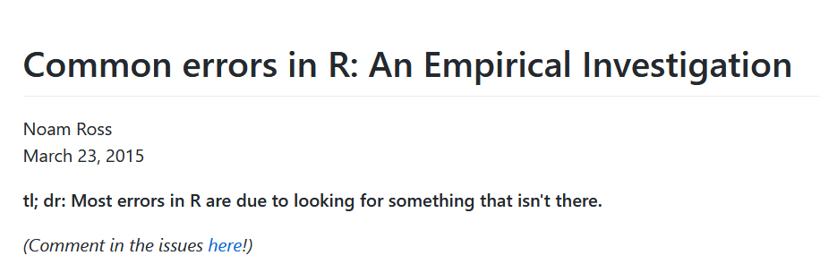
R produces over 10,000 errors :/
Errors
Intro
R Review
Stack Trace
Debugging
Linux

Slide 26
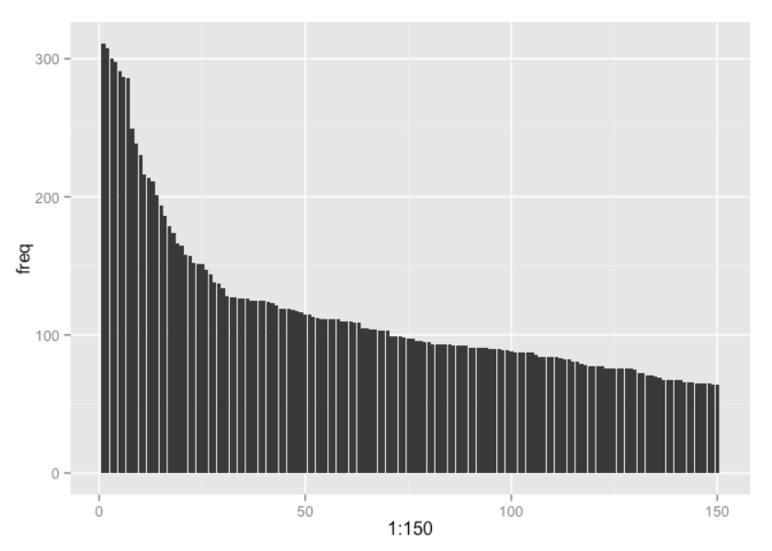
BUT…some are more common!
Ross 2015
Errors
Intro
R Review
Stack Trace
Debugging
Linux

Slide 27
Most common errors in R
"could not find function" | Usually caused by typos or forgetting to load package
"Error in if" | Non-logical or missing data passed to “if” statement
“Error in eval” | Trying to reference an object that doesn’t exist
"cannot open" | Trying to read a file that doesn’t exist/is misplaced
"no applicable method" | Using a function on a data type it doesn’t support
"subscript out of bounds" | Trying to access element/dimension that doesn’t exist
“…package…” | Failure to install, compile, or load package
https://blog.revolutionanalytics.com/2015/03/the-most-common-r-error-messages.html
Errors
Intro
R Review
Stack Trace
Debugging
Linux

Slide 28

So, I found the error – how do I fix it?
Adapted from Dr. Jenny Bryan (@JennyBryan)’s talk for rstudio::conf 2020
1) RESET
2) REPREX
3) DEBUG
(4) DETER)
Debugging
Intro
R Review
Stack Trace
Errors
Linux

Slide 29

1) RESET – try the same thing again
computer
Debugging
Intro
R Review
Stack Trace
Errors
Linux

Slide 30
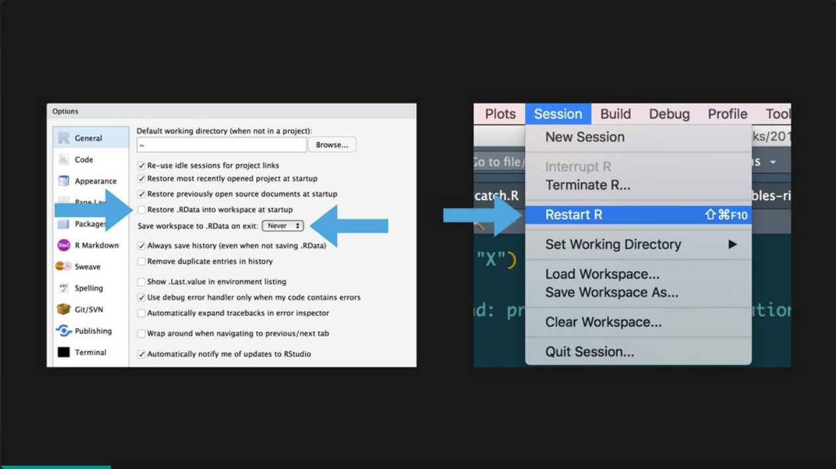
Have you tried turning it off and back on?
Jenny Bryan
Debugging
Intro
R Review
Stack Trace
Errors
Linux

Slide 31
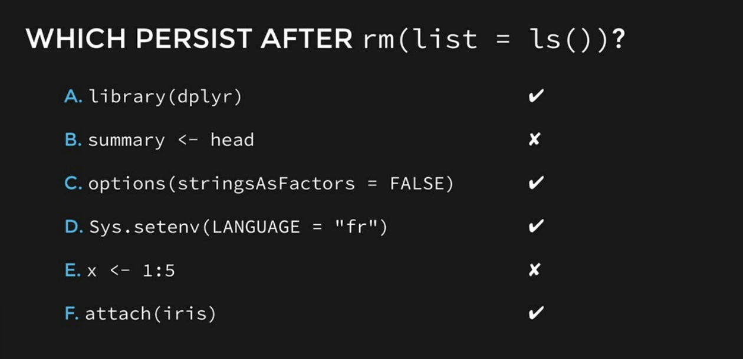
rm(list = ls()) will not reset your environment!
Jenny Bryan
Debugging
Intro
R Review
Stack Trace
Errors
Linux

Slide 32
rm(list = ls()) will not reset your environment!
Jenny Bryan
Debugging
Intro
R Review
Stack Trace
Errors
Linux

Slide 33

R sessions are crops, not houseplants
Jenny Bryan
Debugging
Intro
R Review
Stack Trace
Errors
Linux

Slide 34

2) REPREX (Minimum Reproducible Example)
Jenny Bryan
Debugging
Intro
R Review
Stack Trace
Errors
Linux

Slide 35

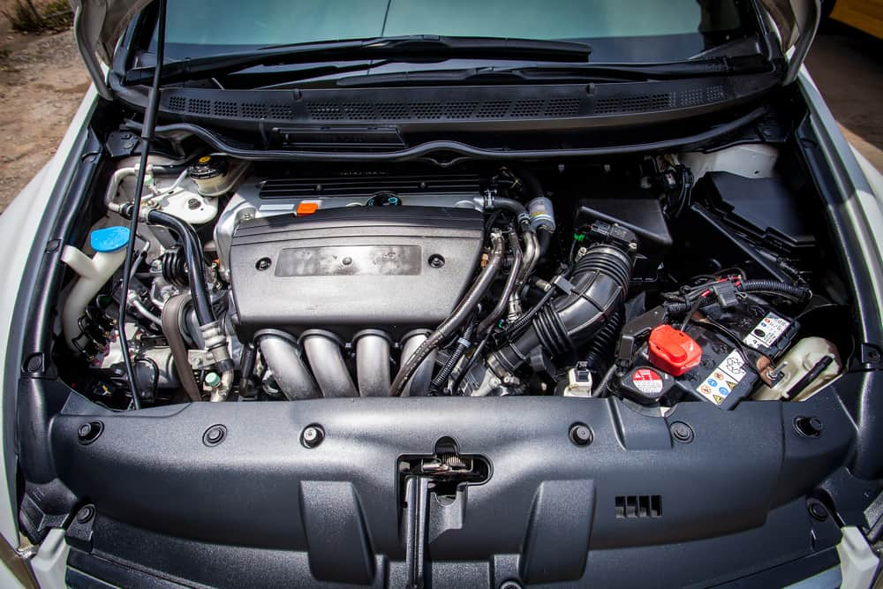
What is a reproducible example?
A method of zeroing in on your problem
My engine is broken!
Oh, my gas cap is loose
Debugging
Intro
R Review
Stack Trace
Errors
Linux

Slide 36
How to make a reproducible example:
Minimal: Use as little code as possible that still produces the same problem
Complete: Provide all parts someone else would need to reproduce your problem
Reproducible: Test the code to make sure it reproduces the problem
Debugging
Intro
R Review
Stack Trace
Errors
Linux

Slide 37
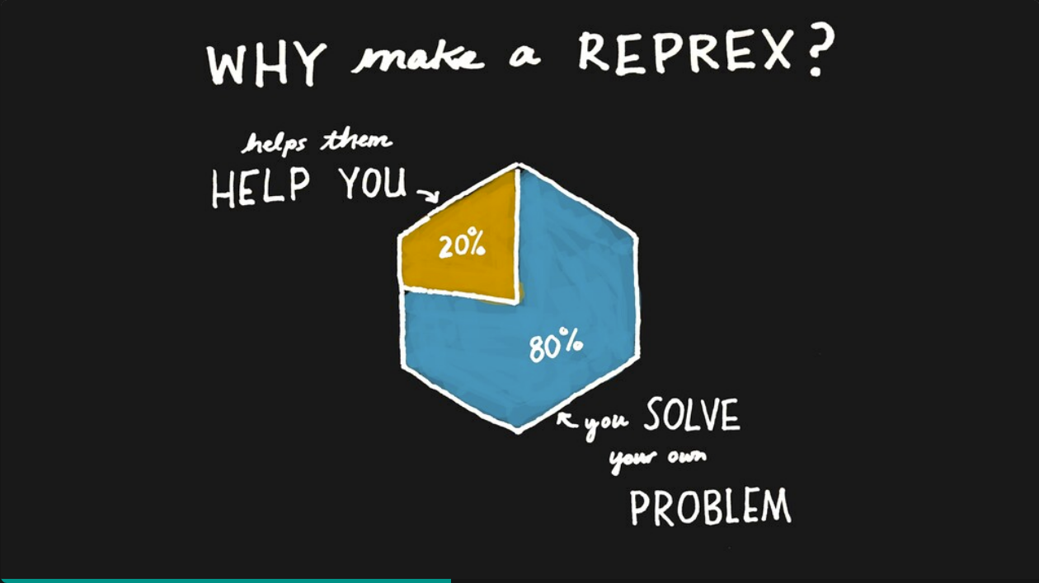
Jenny Bryan
Debugging
Intro
R Review
Stack Trace
Errors
Linux

Slide 38

Why reprex?
Jenny Bryan
Debugging
Intro
R Review
Stack Trace
Errors
Linux

Slide 39
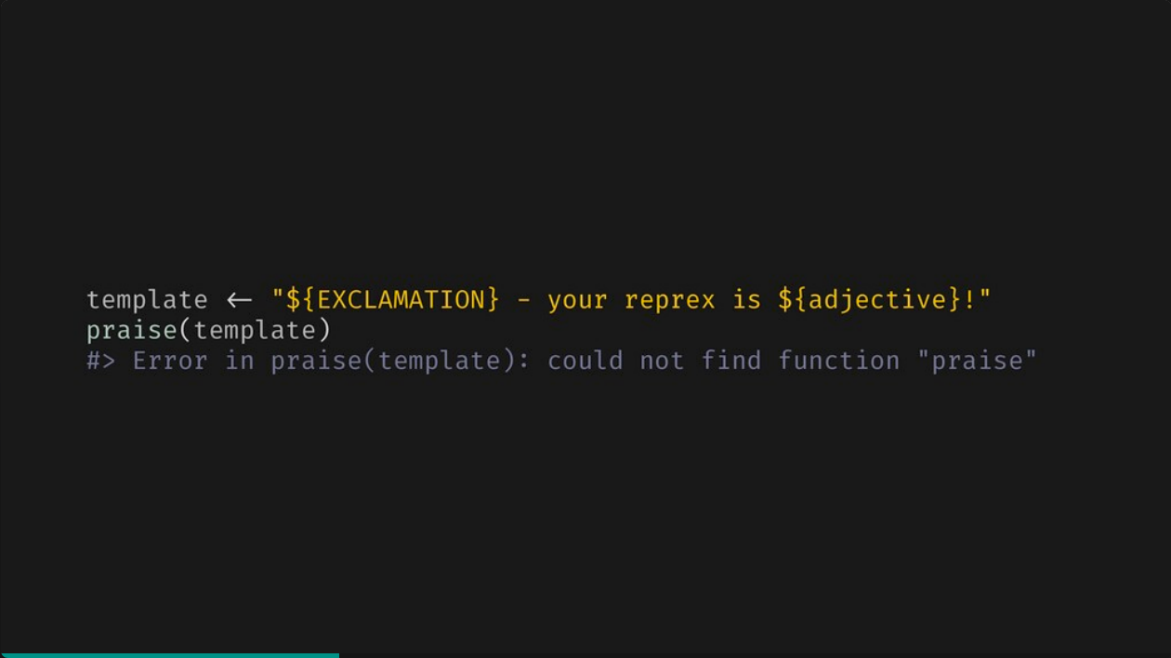
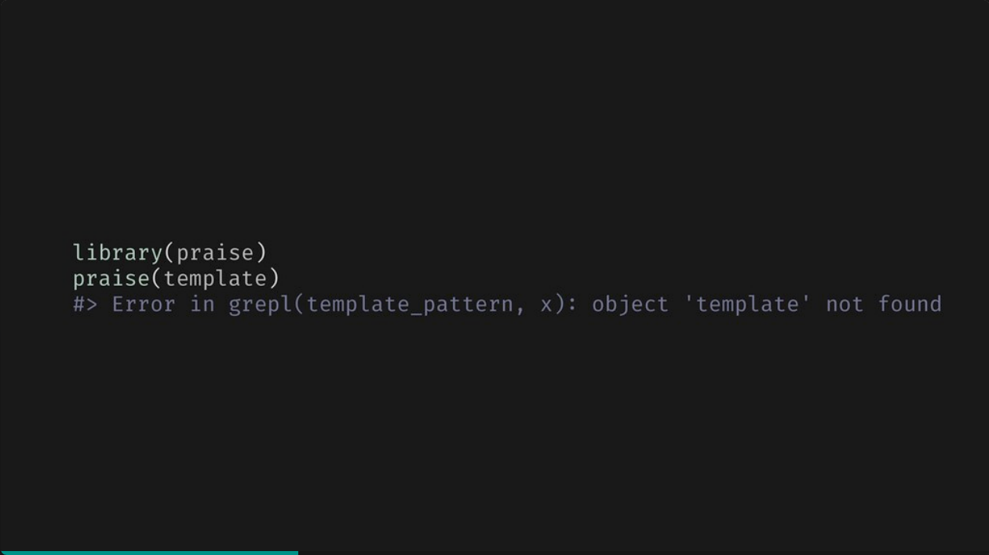
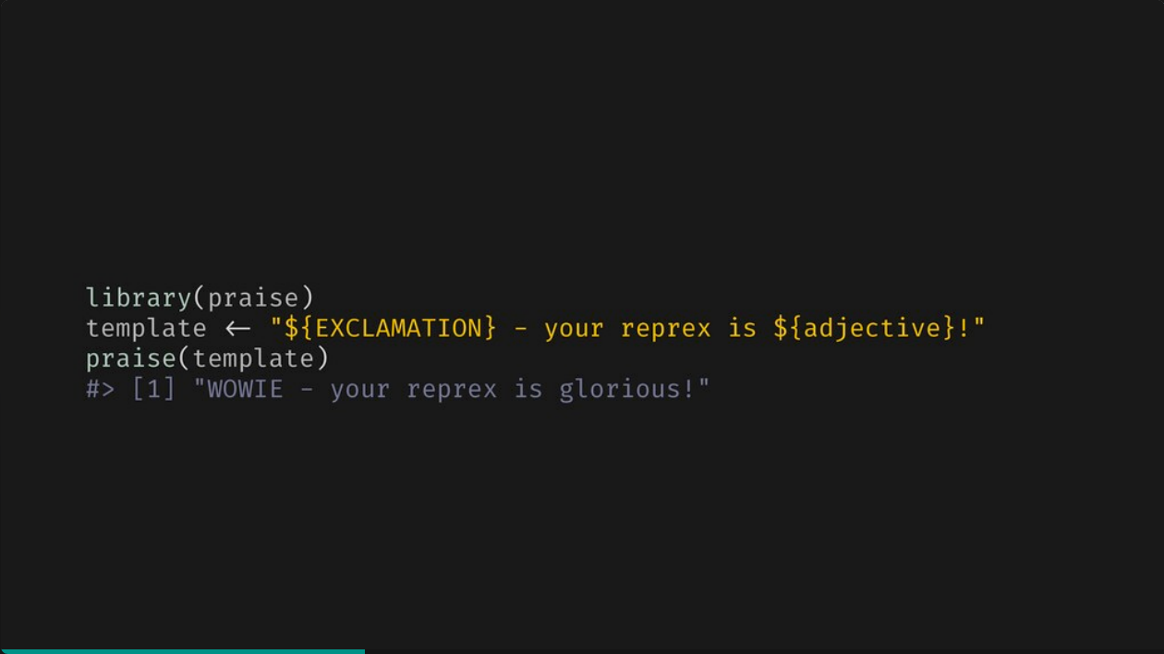
Too little information
Missing a package (praise)
Missing an object (template)
Everything we need!
Jenny Bryan
Debugging
Intro
R Review
Stack Trace
Errors
Linux

Slide 40
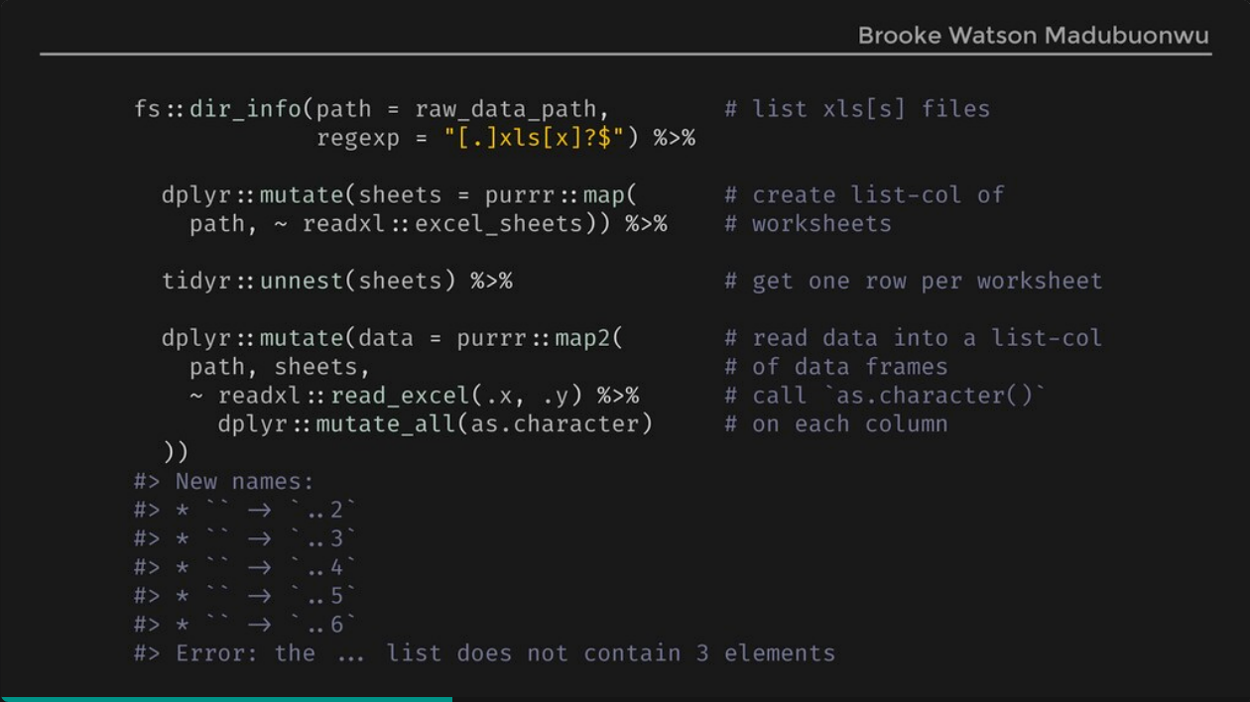
Too much information
Jenny Bryan
Debugging
Intro
R Review
Stack Trace
Errors
Linux

Slide 41
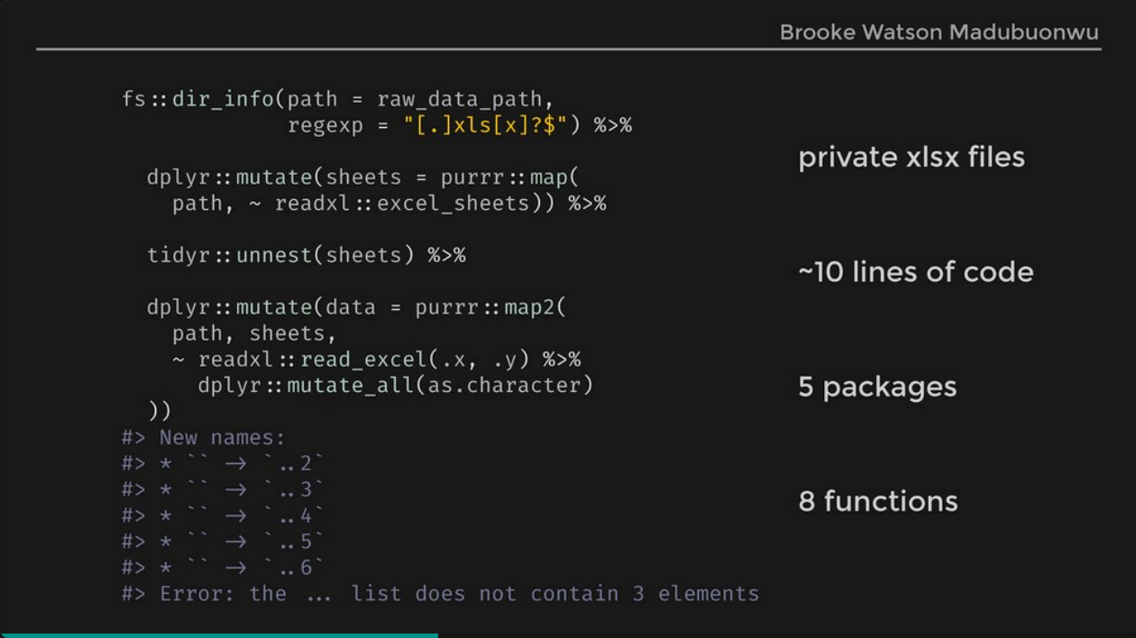
Too much information
Jenny Bryan
Debugging
Intro
R Review
Stack Trace
Errors
Linux

Slide 42
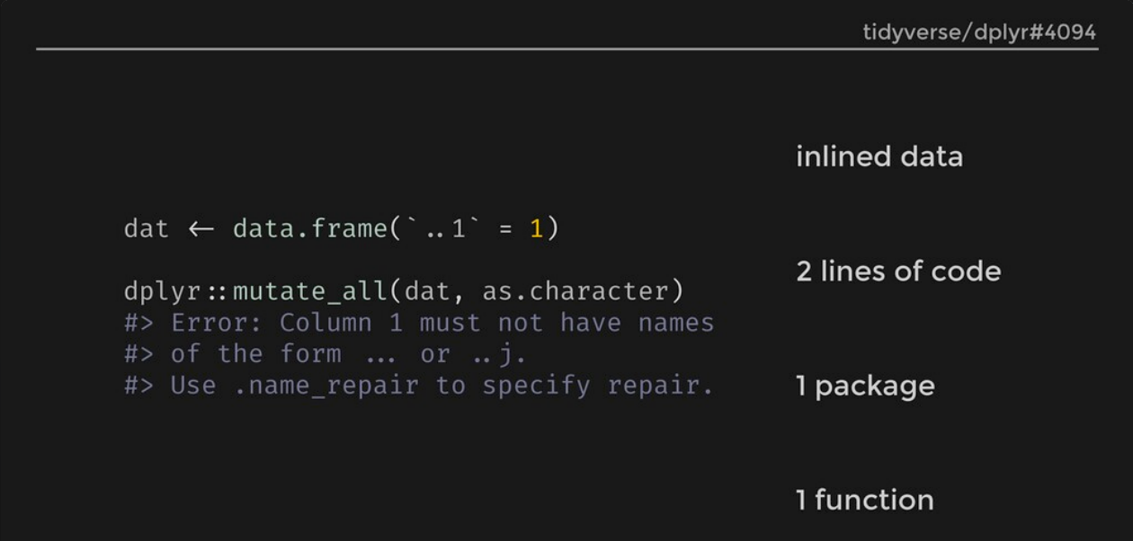
Just right!
Jenny Bryan
Debugging
Intro
R Review
Stack Trace
Errors
Linux

Slide 43
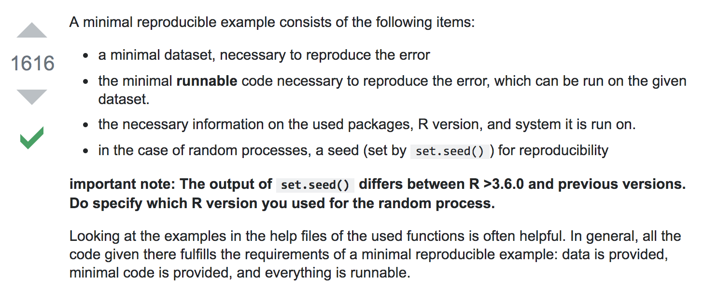
#Exercise 3: Make your own reprex
Debugging
Intro
R Review
Stack Trace
Errors
Linux

Slide 44
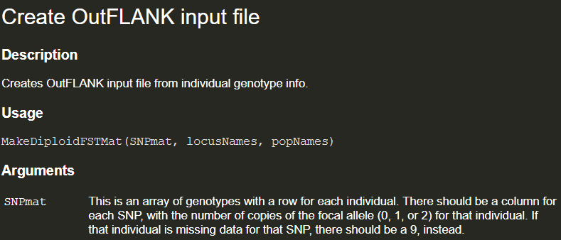
3) DEBUG – if you’re using functions from a library, start at the documentation
?MakeDiploidFSTMat()
browseVignettes(OutFLANK)
Debugging
Intro
R Review
Stack Trace
Errors
Linux

Slide 45
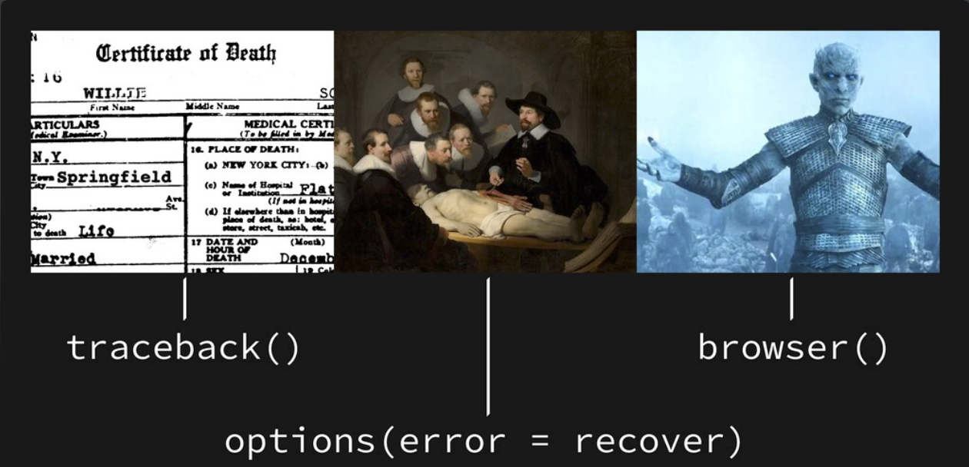
R has built-in debugging tools!
Jenny Bryan
Debugging
Intro
R Review
Stack Trace
Errors
Linux
Notes:
Traceback – list of what is called on your way to error
Changing error option in R – can inspect what’s going on right before the error
Browser – can interrupt/change the process before the error

Slide 46
#Exercise 4: Using traceback() to explore an error
Debugging
Intro
R Review
Stack Trace
Errors
Linux
Notes:
Traceback – list of what is called on your way to error
Changing error option in R – can inspect what’s going on right before the error
Browser – can interrupt/change the process before the error

Slide 47


Sometimes, debugging = advanced googling
If all else fails, take it to the Internet! Have other people had this problem?
Debugging
Intro
R Review
Stack Trace
Errors
Linux

Slide 48
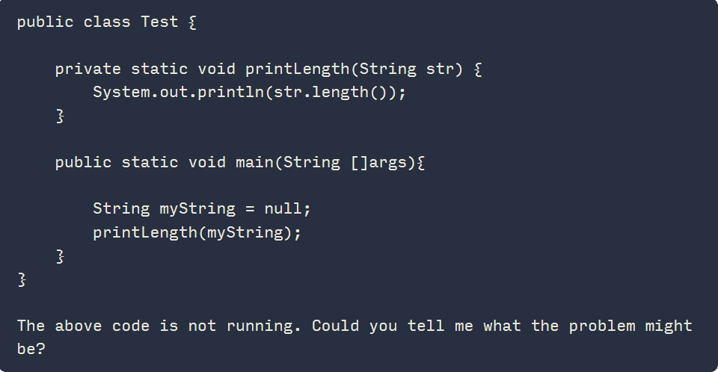
A quick note about ChatGPT
I won’t tell you not to use it, but:
Remember that it’s a chatbot – regurgitates google searches
It’s more useful for “dumb”/easy bugs
Don’t use it as a crutch
Debugging
Intro
R Review
Stack Trace
Errors
Linux

Slide 49
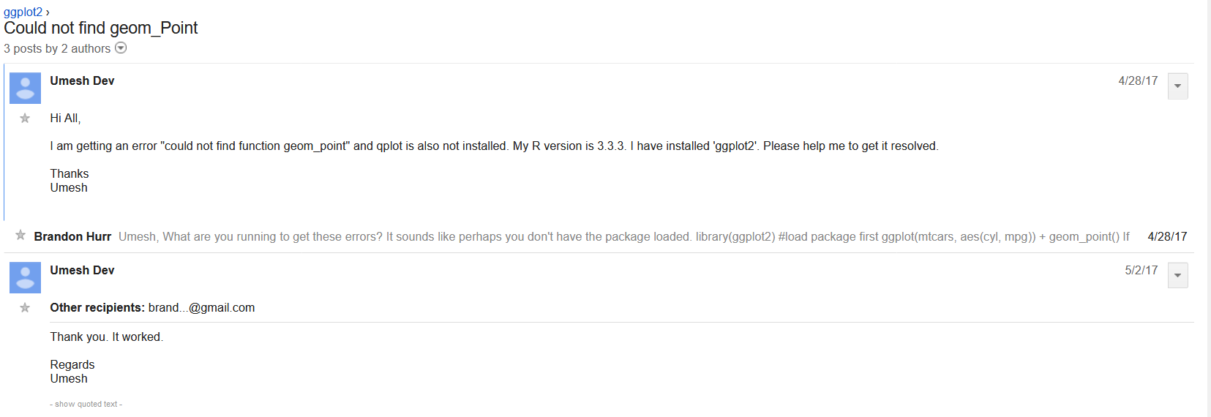
Don’t get cocky – save your solutions
If you hit an error, write it down
If you find a solution to your error, write it down
Debugging
Intro
R Review
Stack Trace
Errors
Linux

Slide 50
Ask for help early and often
If you’ve already googled and checked the relevant Github Issues page, just ask!
Ask StackOverflow – include reprex and sessionInfo() if needed
If the software/library has a Google Group or similar, ask there
Reach out to the software/library developer (often on GitHub)
Debugging
Intro
R Review
Stack Trace
Errors
Linux

Slide 51

QUICK tips for problem solving in BASH / Unix
Linux
Intro
R Review
Stack Trace
Errors
Debugging

Slide 52

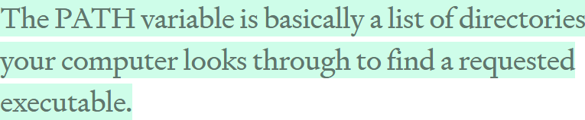
It’s all about finding the (shell) path
/usr/local/bin/fastqc
medium.com/@jalendport
> fastqc
Linux
Intro
R Review
Stack Trace
Errors
Debugging

Slide 53
What’s normally in your PATH?
/bin/
/sbin/
/usr/bin/
/usr/sbin/
/usr/local/bin/
/usr/local/sbin/
Executable files are all over our computer!
The command echo $PATH shows us what’s currently there
Linux
Intro
R Review
Stack Trace
Errors
Debugging

Slide 54

What can go wrong?
Multiple installations – PATH checks directories in the order they are listed
If you have programs installed in weird places, PATH doesn’t know about them
Linux
Intro
R Review
Stack Trace
Errors
Debugging

Slide 55

What can we do about it?
Always check where programs are being installed
Do your best to avoid multiple installations
If you need to, add to PATH or create aliases
Linux
Intro
R Review
Stack Trace
Errors
Debugging

Slide 56
Two methods for getting our computer to recognize weird installs
Add to PATH:
export PATH=$PATH:~/Library/Python/2.7/bin/
export PATH=~/Library/Python/2.7/bin/:$PATH
2) Set up an alias:
alias couchapp="~/Library/Python/2.7/bin/couchapp"
Linux
Intro
R Review
Stack Trace
Errors
Debugging

Slide 57

My changes went away!
Custom PATH environment
Useful aliases
Linux
Intro
R Review
Stack Trace
Errors
Debugging

Slide 58
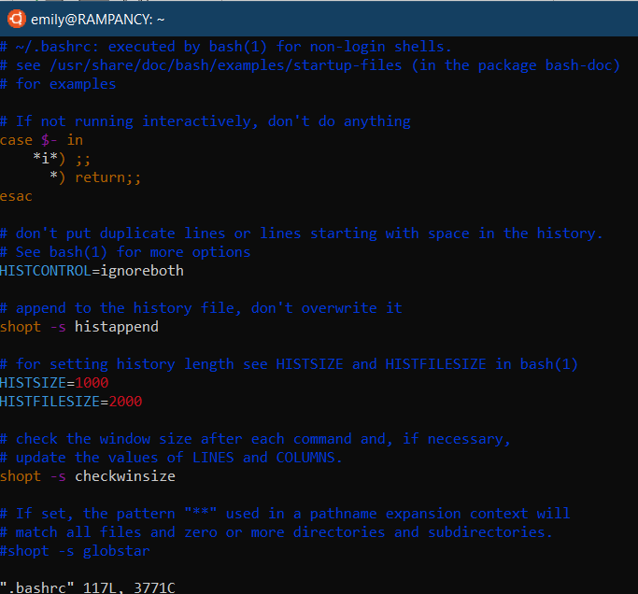
Preserving your PATH/aliases
Add lines to your .bashrc or .bash_profile file using a program like vim or nano (vim .bashrc)
Linux
Intro
R Review
Stack Trace
Errors
Debugging

Slide 59


How do we avoid weird installs in the first place?
When possible, use a package manager like
apt-get (Linux), chocolatey (Windows) or homebrew (macOS)
Linux
Intro
R Review
Stack Trace
Errors
Debugging

Slide 60
Apt-get is your friend
apt-get install <packagename>
apt-get remove <packagename>
Apt-get can only install what it knows about! To update apt databases:
apt-get update
Add new repositories to:
/etc/apt/sources.list
Linux
Intro
R Review
Stack Trace
Errors
Debugging

Slide 61
In summary:
For R problems, remember R basics
If your variables are out of hand, try a stack trace
Break down error messages
Reset, reprex, debug
Google and ask for help the smart way
Many Linux issues are caused by weird installations or PATH problems
Intro
R Review
Stack Trace
Errors
Debugging
Linux

Slide 62
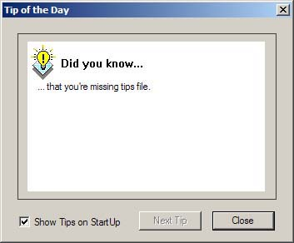
Questions?
Intro
R Review
Stack Trace
Errors
Debugging
Linux

